Slide 2
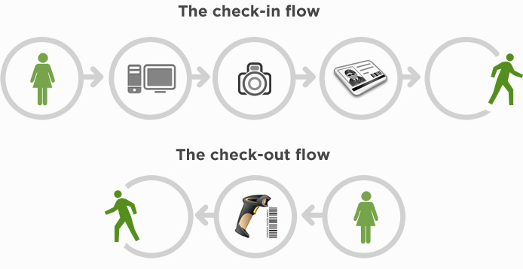
Visitor Management Software

Slide 3
Features
Complete Information gathering of the visitor
Integrated Sms & Email Facility
Multiple Reports
Daily Reports, Area wise Reports, in between hours
Generating New Gate Passes from existing data.
Advanced booking for the appointment.
MULTI Role SUPPORT
HR - Admin / Security Manager / Operator

Slide 4
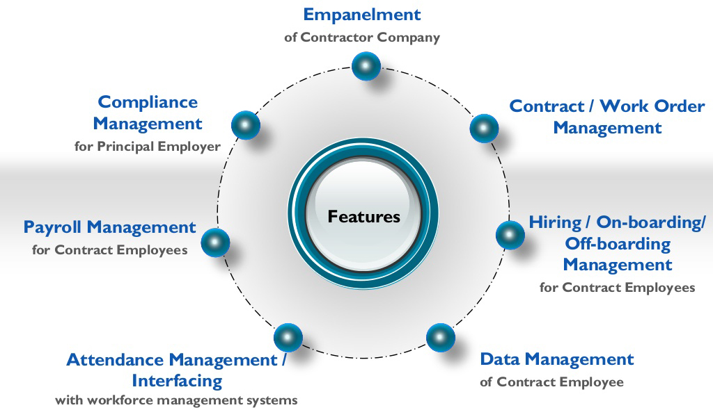
Your Company LOGO

Slide 8
Integrated with SMS (Email / SMS Alert (Optional))

Slide 9
VMS Reports

Slide 10
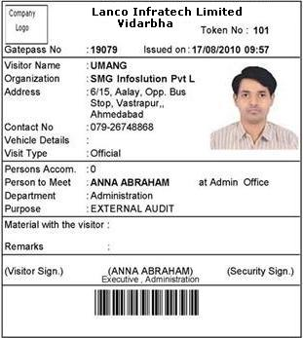
ID Card

Slide 11
Contact : 04040271894, 8341102235

