Slide 2
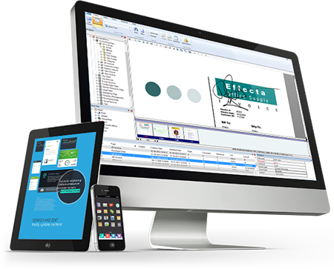
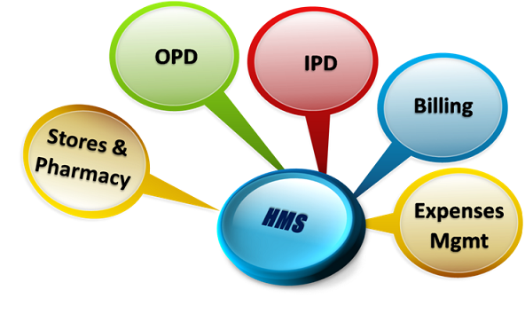

Slide 3
Admin Module
Doctor Module
Receptionist Module
Accountant Module
Laboratory Module
Pharmacy Module
Contact Us

Slide 4
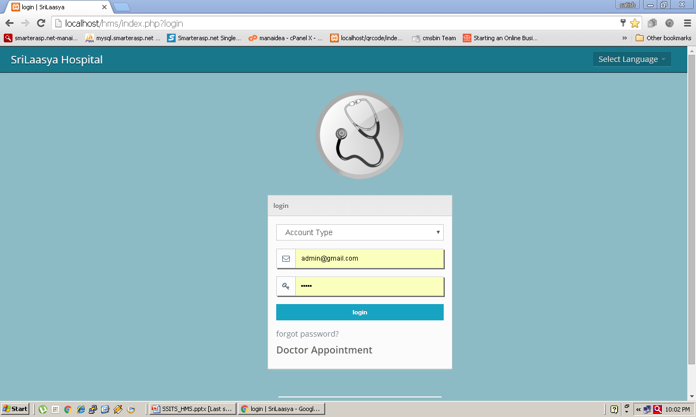
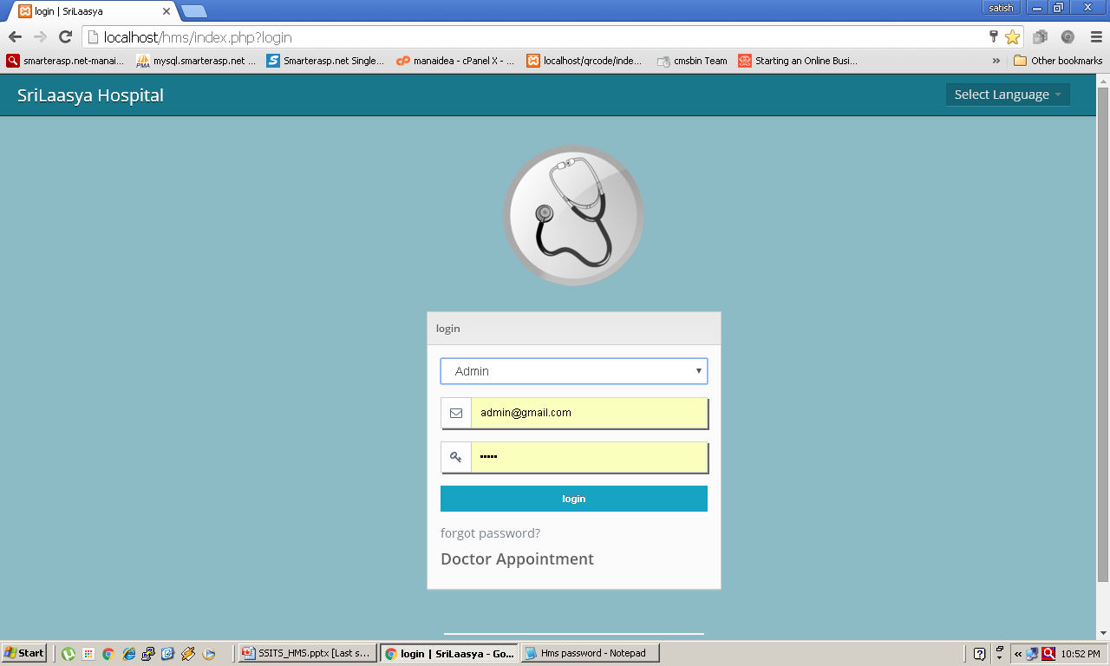
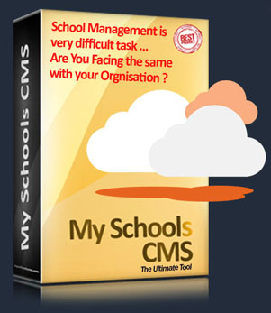
Don’t worry we help you to resolve the problem. You are just away from Click a Button for easy and smooth Management without worry, where ever you are across the globe.
Mobile / Tab / Laptop or PC
Save Time & Money
Better Utilization School Resources
Please do not hesitate to talk to our Representatives, Live Chat Support available.
Next >

Slide 5
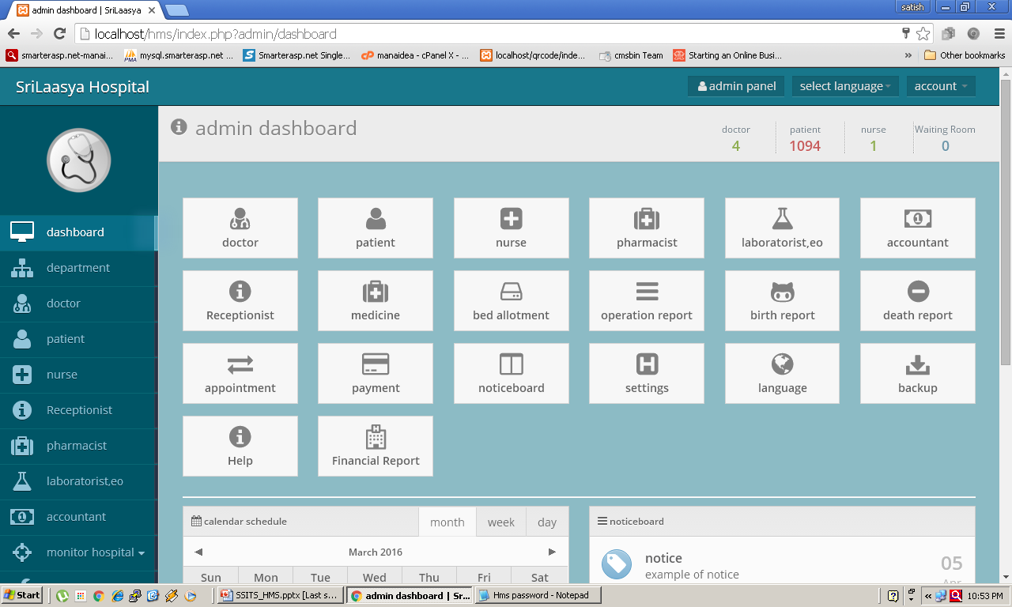
< Previous
Next >

Slide 6
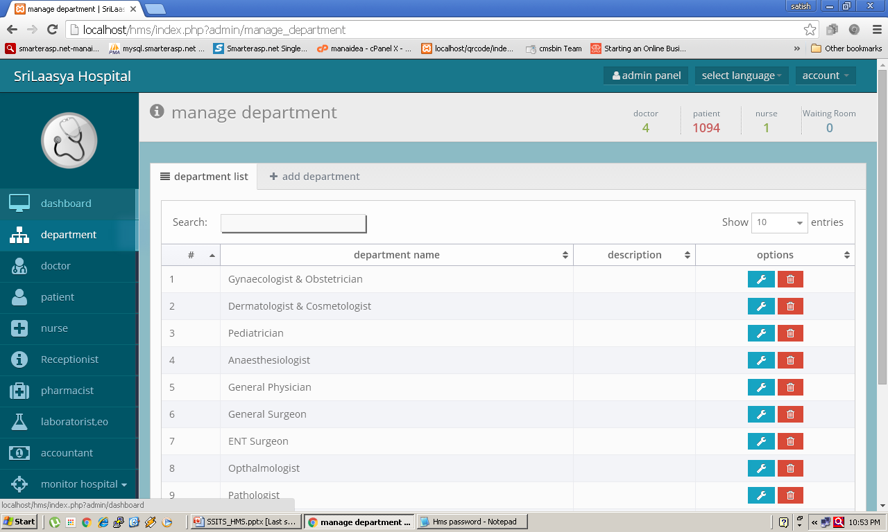
< Previous
Next >

Slide 7
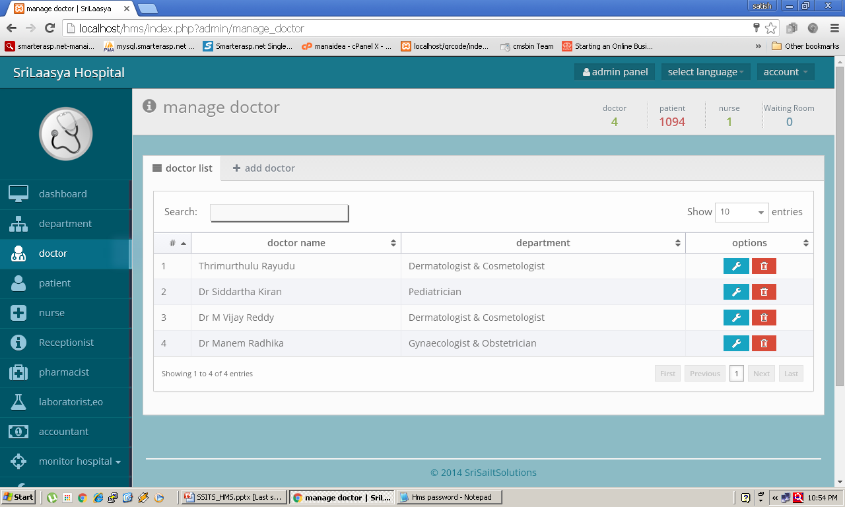
< Previous
Next >

Slide 8
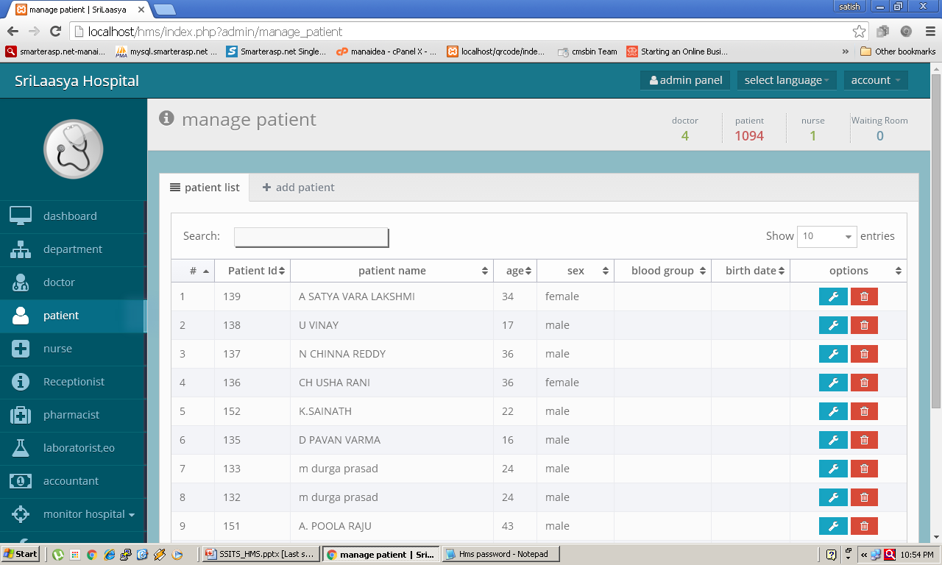
< Previous
Next >

Slide 9
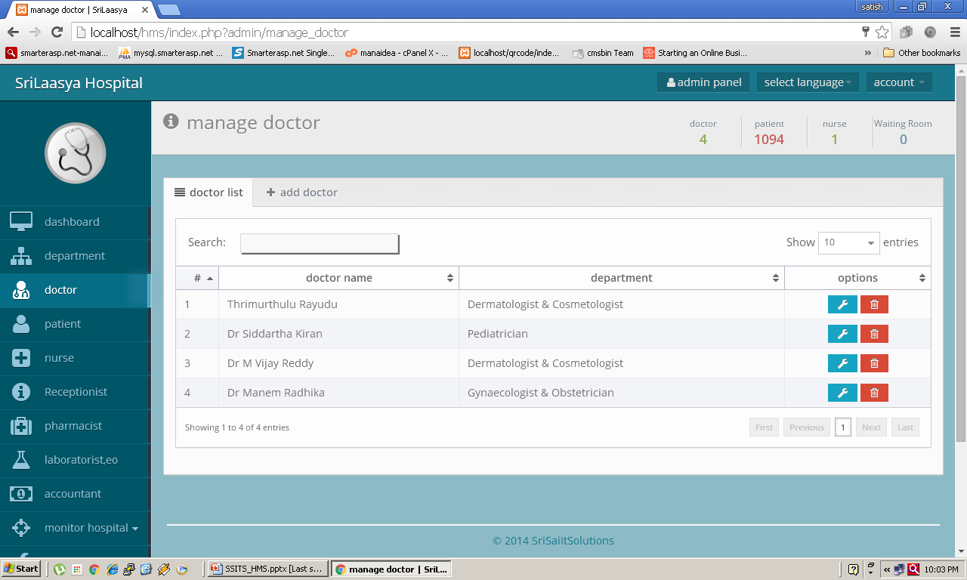
About Us
Core Team
Why MySchools CMS ?
99 Reasons
Core Modules
ERP Slides
Pricing
Contact
< Previous
Next >

Slide 10
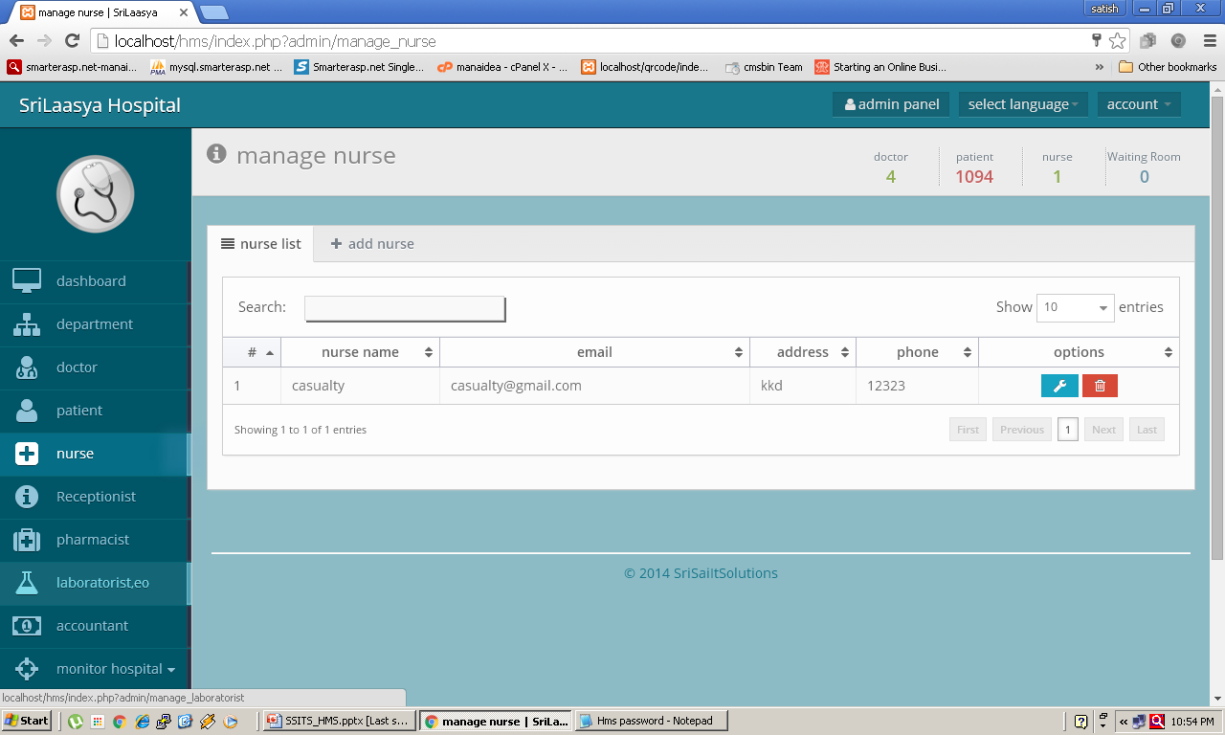
< Previous
Next >

Slide 11
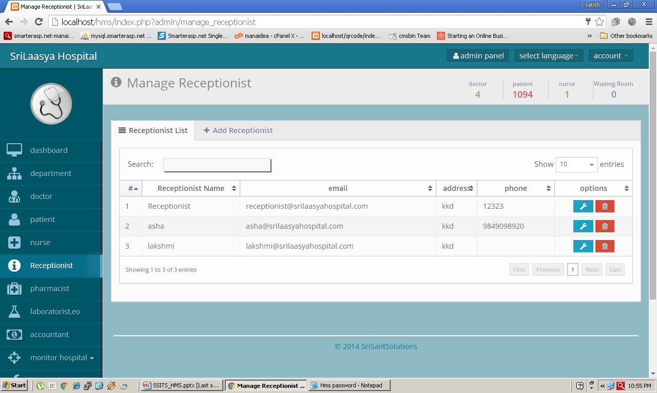
< Previous
Next >

Slide 12
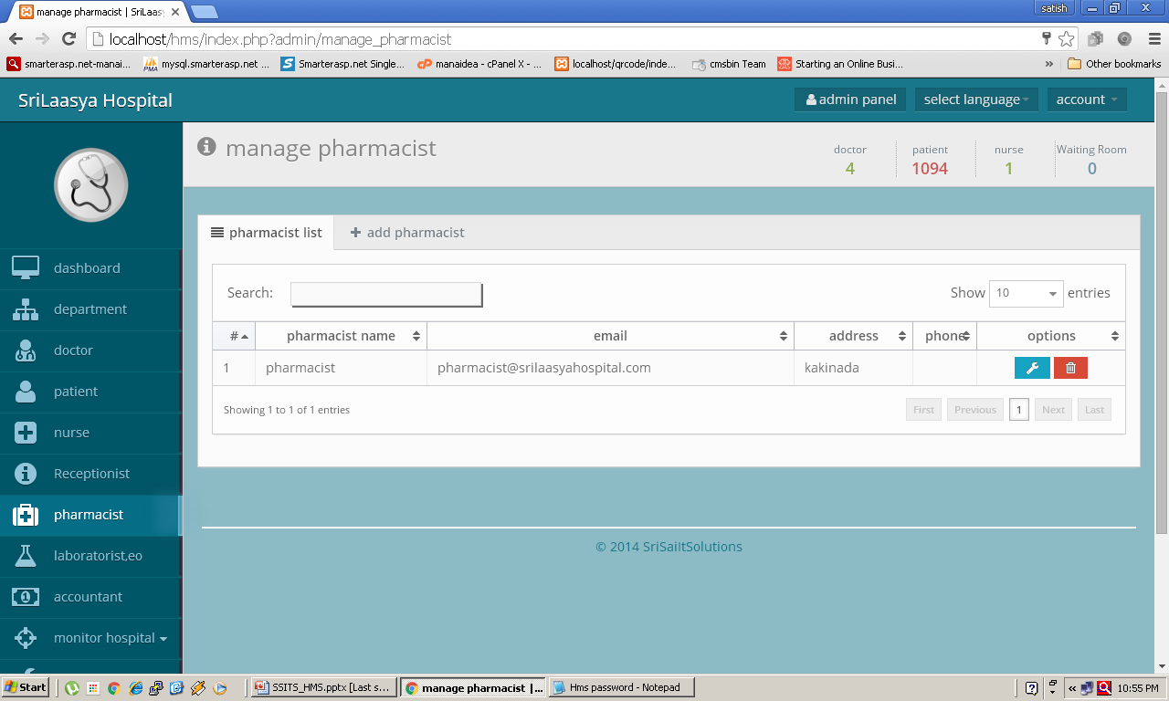
< Previous
Next >

Slide 13
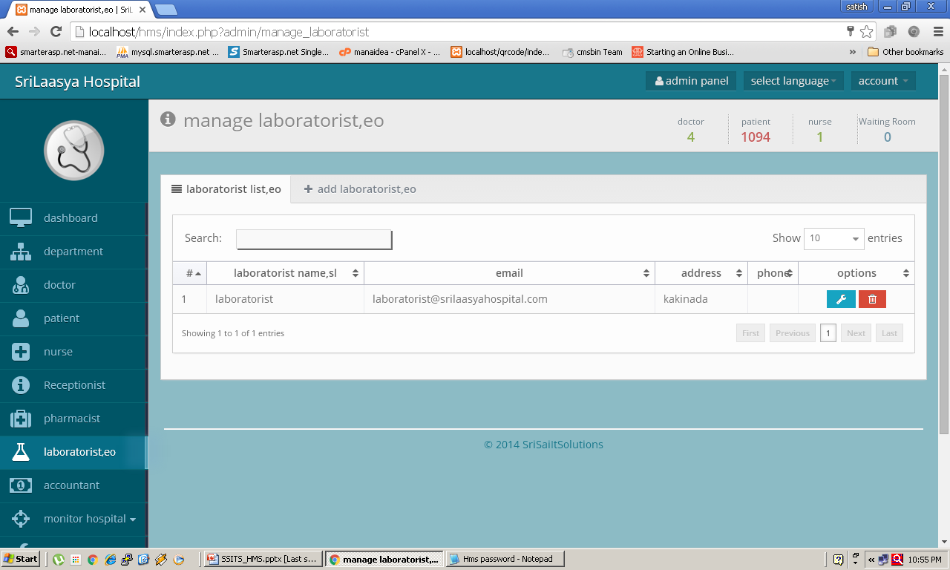
< Previous
Next >

Slide 14
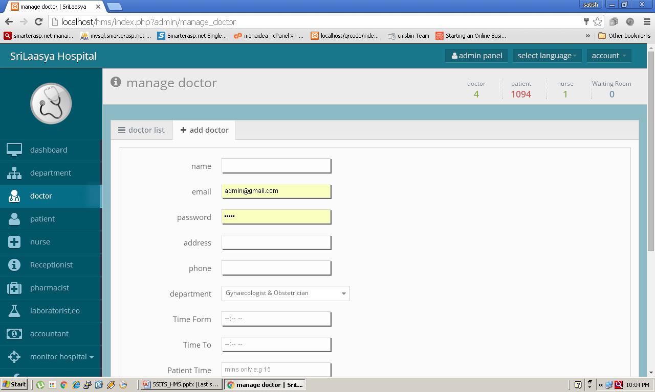
Our History
1998
Our product is initially developed with DOS based applications, we got vast experience in educational institution management since 1998. Basically we supply and support Hardware & Network Services to all Educational Institutions, after two years …
2003 - 2006
in the Year 2003 we started School and College Management Software Offline Product using FoxPro for School management package with single User.
2008 - 2012
in the Year 2008 we moved to Microsoft Visual Basic, MS Access - Windows based. (32 Bit Desktop Application) for Multi User in MS Sql, we have supplied to many schools and colleges, Off-line Package without multi user environment. After some time we are unable to provide the service support to our clients because its OFF-LINE lake technical man power & Microsoft licenses issues, so we moved to Open Source tools and started R & D with open source. After long re search started Web software development, using PHP, MySql unstructured.
2014 – 2015
After some time we started coding with MVC Architecture, after lot of struggles all modules developed for all academic and administrative activities like.. Library Management, Canteen Management, Hostel, School, College Management… etc. modules developed.
In the Year of 2014 Official Launch of MySchoolsCMS and Biometric Device Integration, POS Hand Held Billing Machine, GPS Vehicle Tracking Devices also integrated.
2016
Finally shape up our complete product and start provide services for Common School to International Schools, Corporate Schools - Multi User, Multi Branch, Multi Courses, Multi Logins, Cloud Technology with Mobile and Tablet PC compatibility with SSL Security. We are ready to provide customized solution.
< Previous
Next >

Slide 15
< Previous
Next >

Slide 16
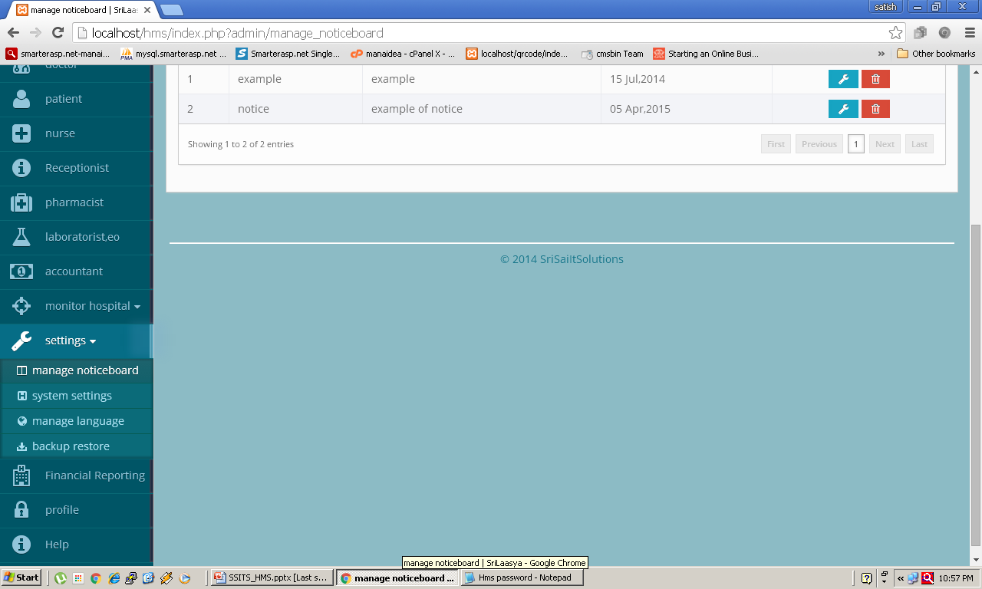
< Previous
Next >

Slide 17
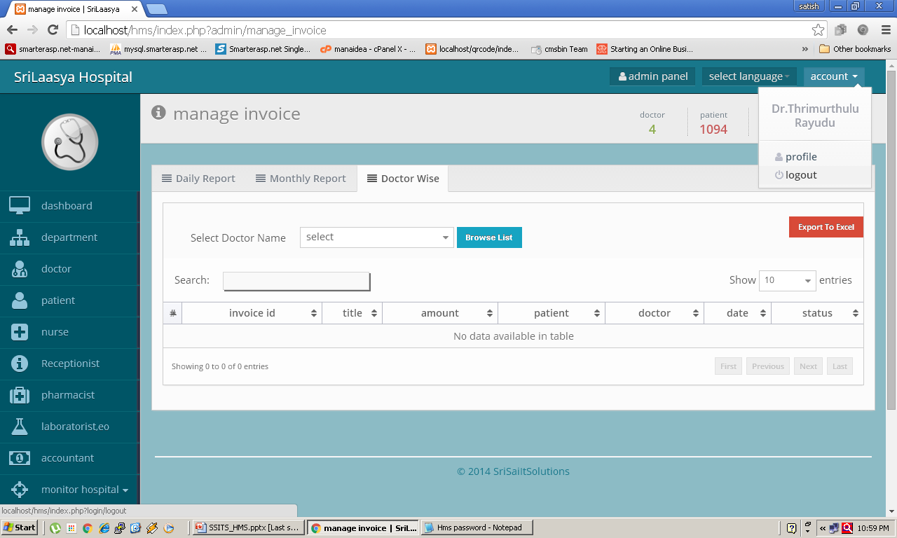
< Previous
Next >

Slide 18
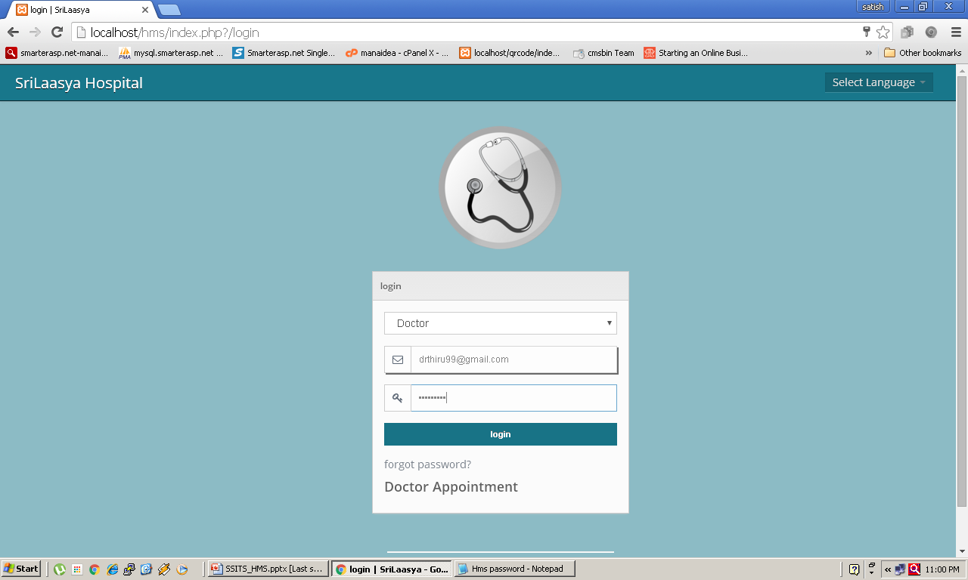
Next >

Slide 19
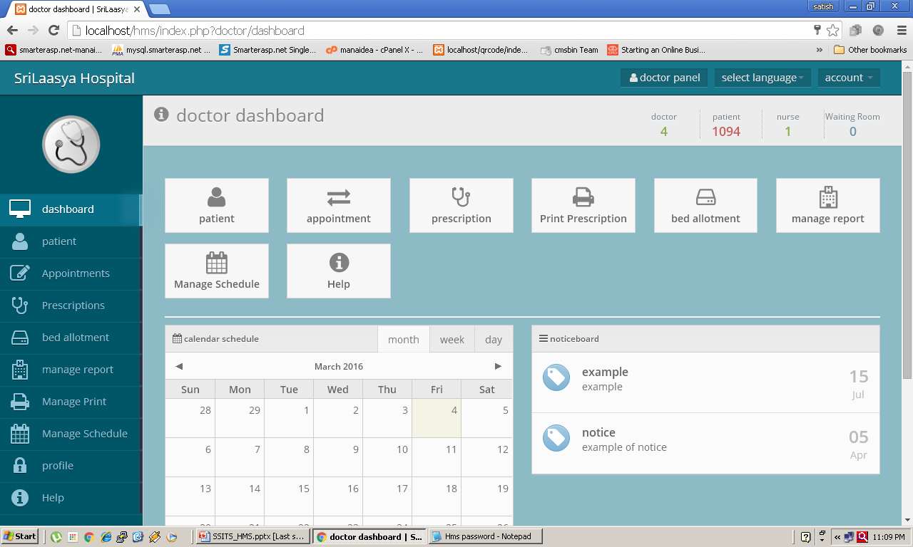
< Previous
Next >

Slide 20
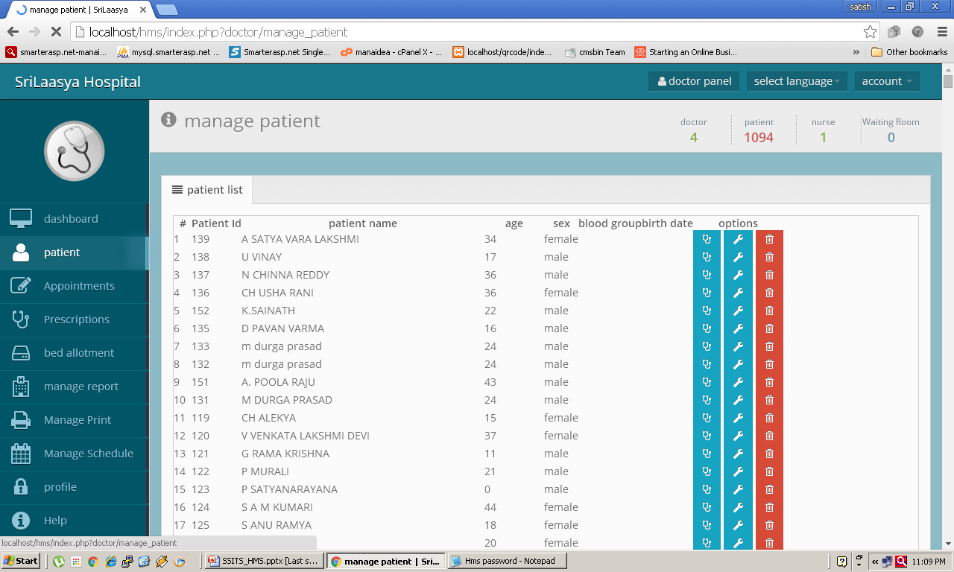
< Previous
Next >

Slide 21
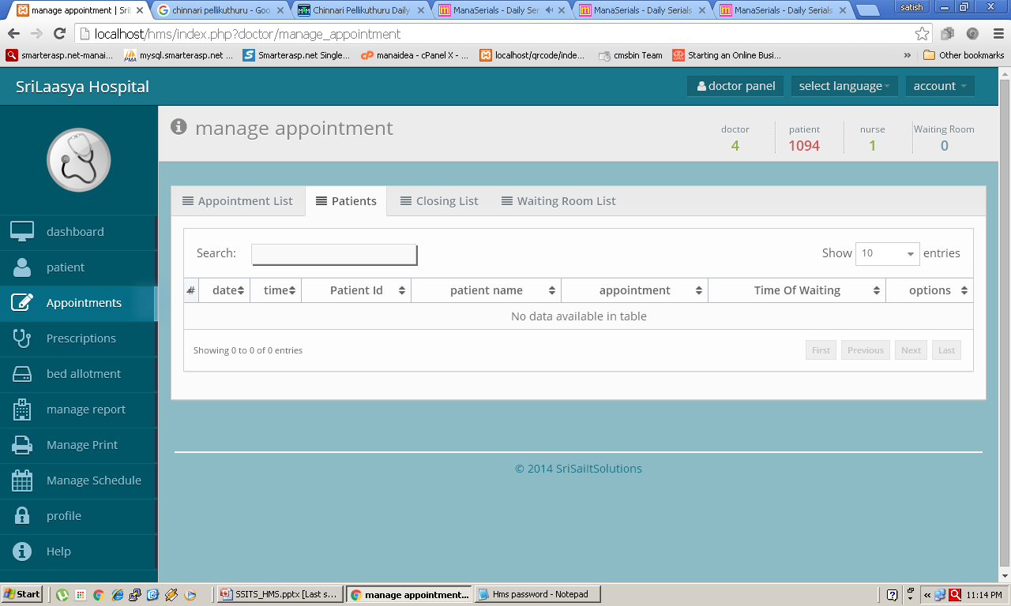
< Previous
Next >

Slide 22
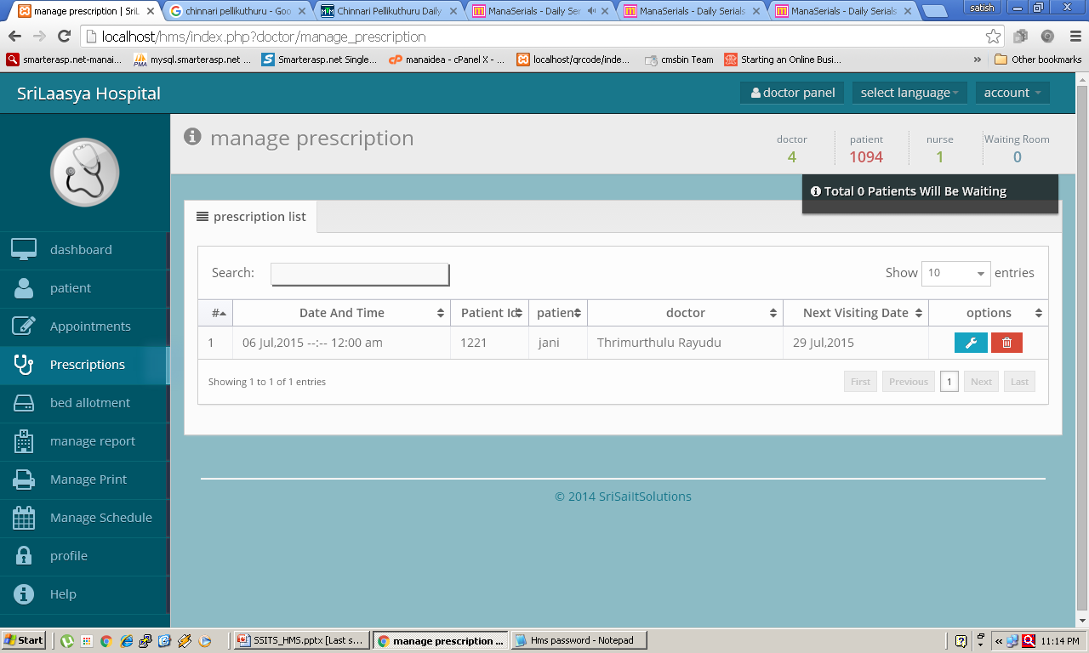
< Previous
Next >

Slide 23
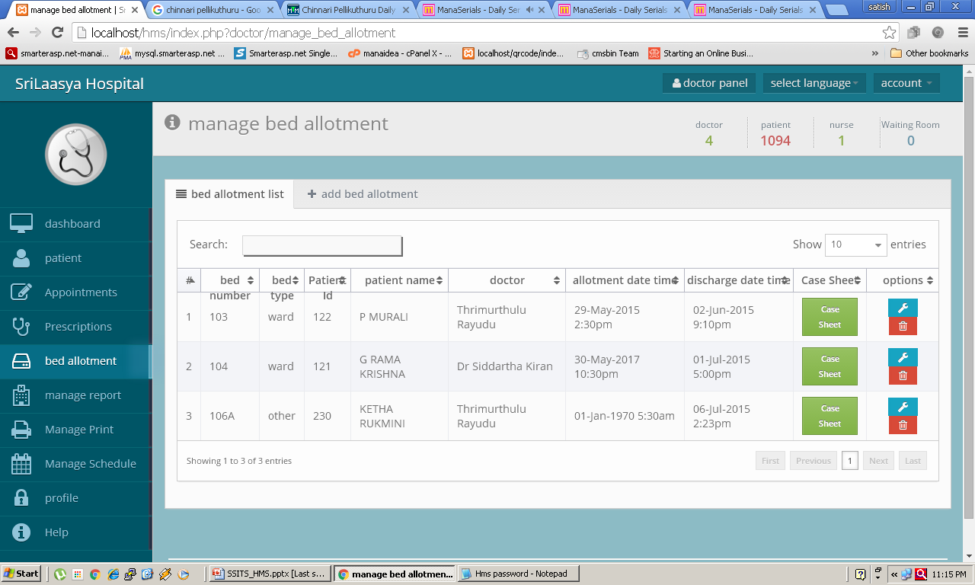
< Previous
Next >

Slide 24
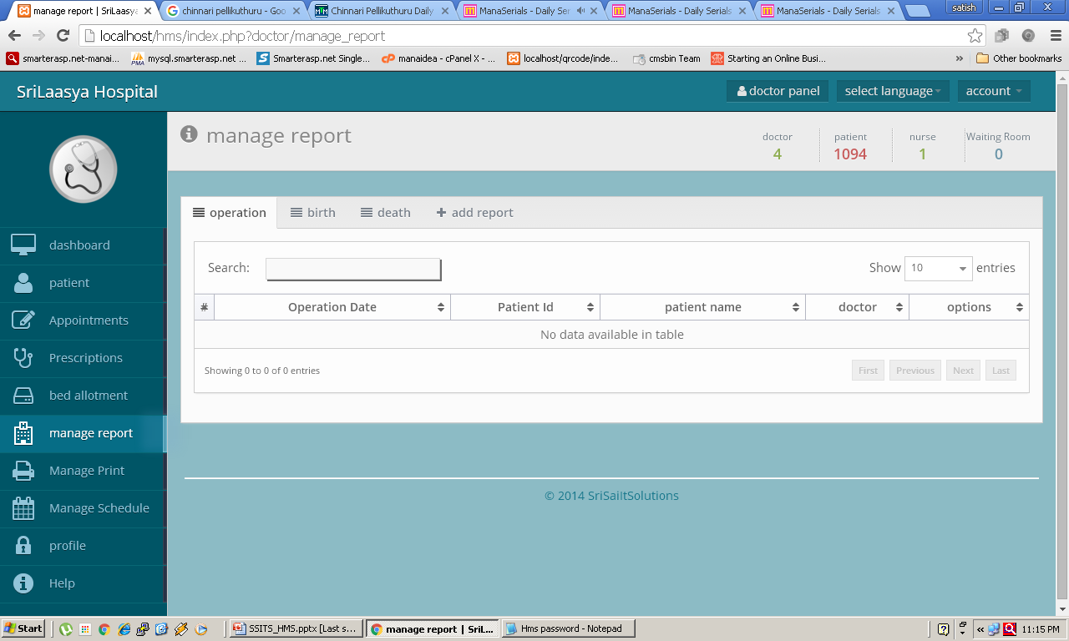
< Previous
Next >

Slide 25
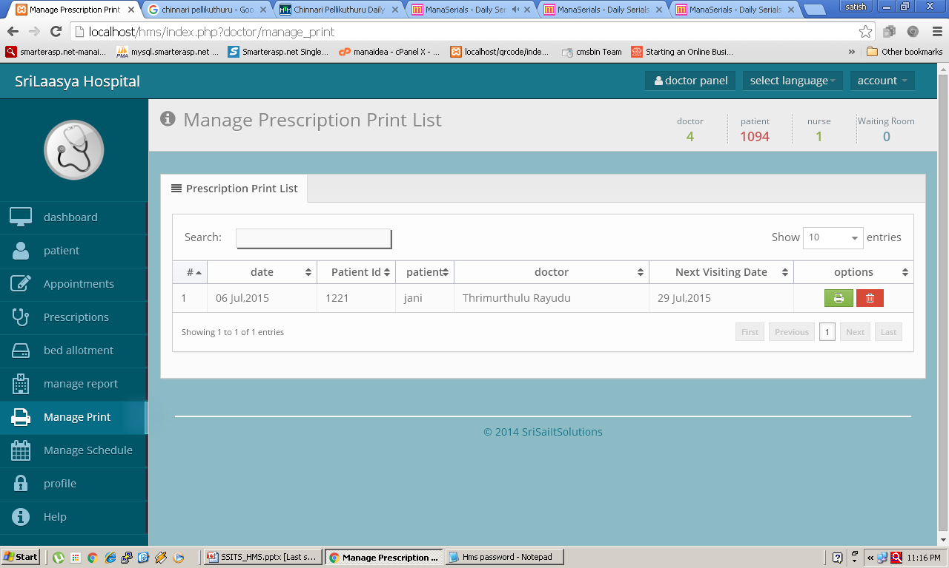
< Previous
Next >

Slide 26
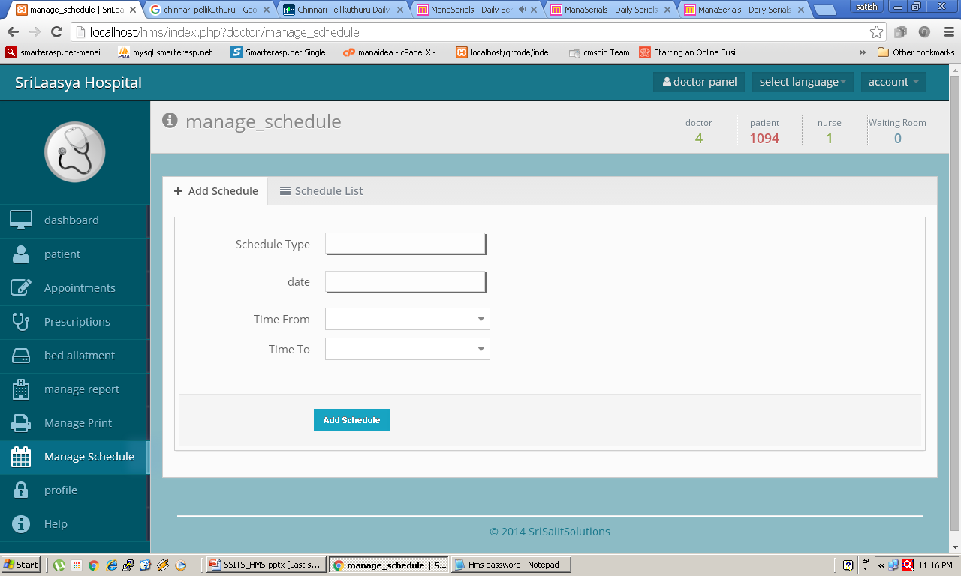
< Previous
Next >

Slide 27
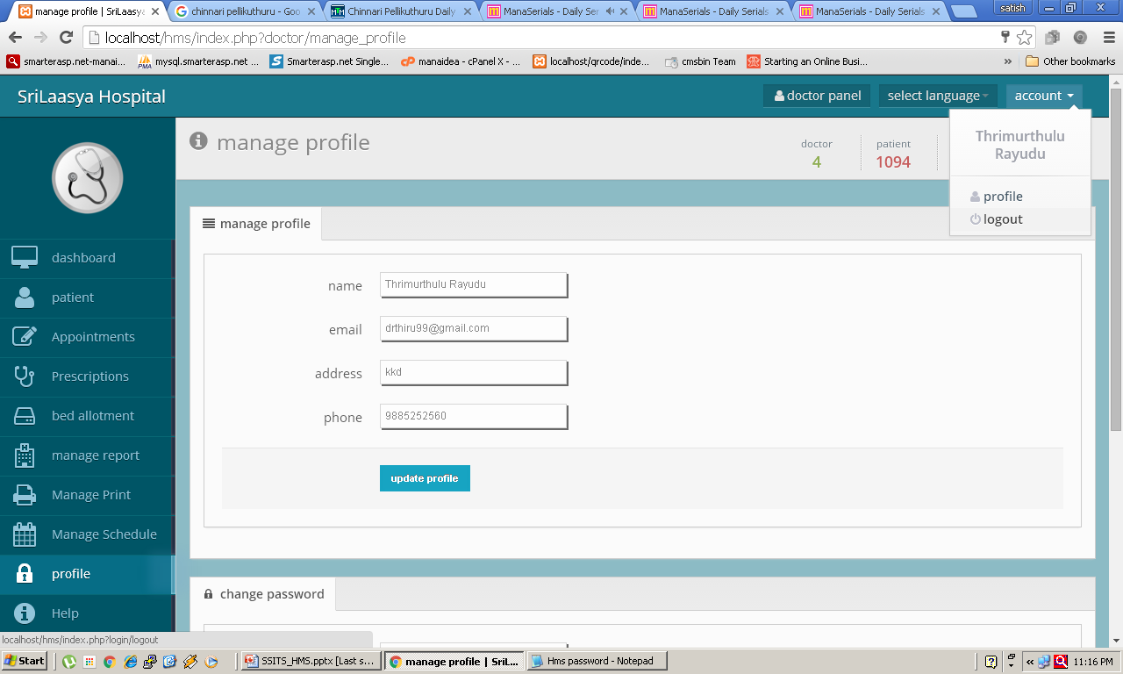
< Previous
Next >

Slide 28
Next >

Slide 29
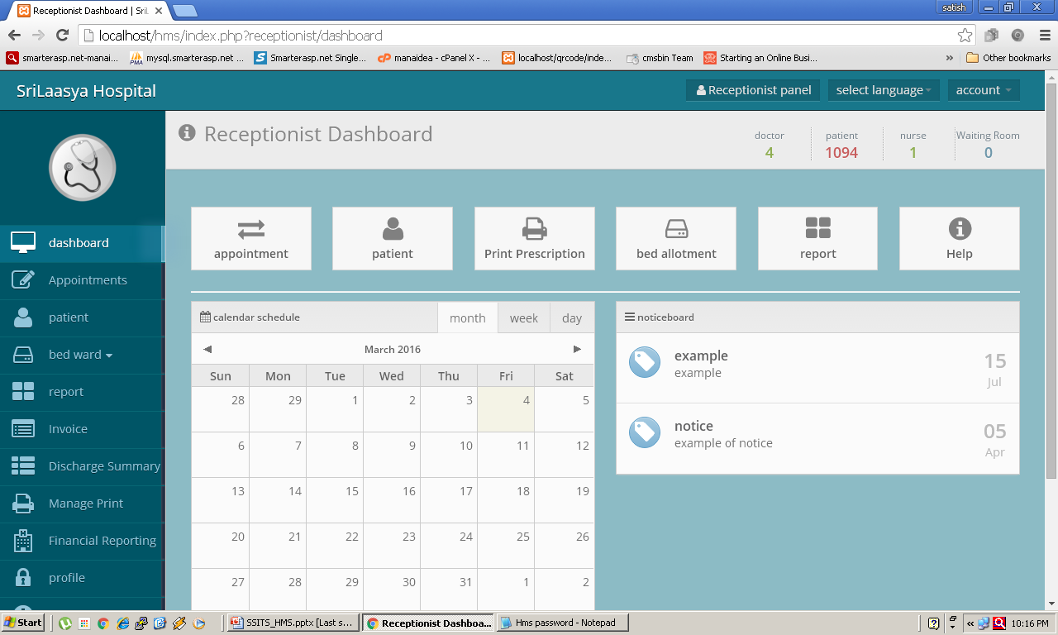
< Previous
Next >

Slide 30
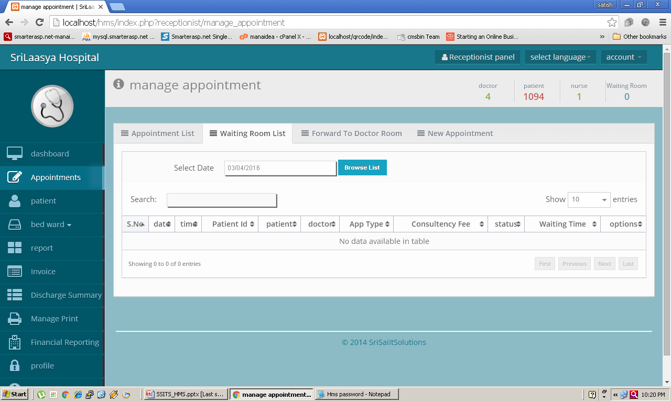
< Previous
Next >

Slide 31
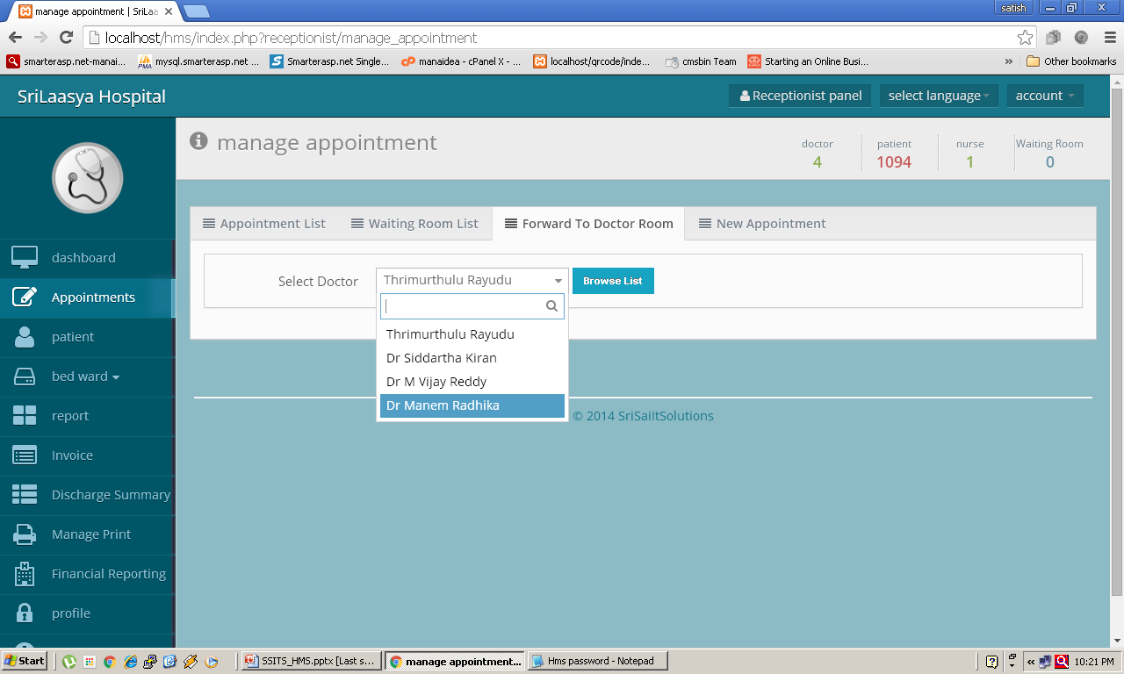
< Previous
Next >

Slide 32
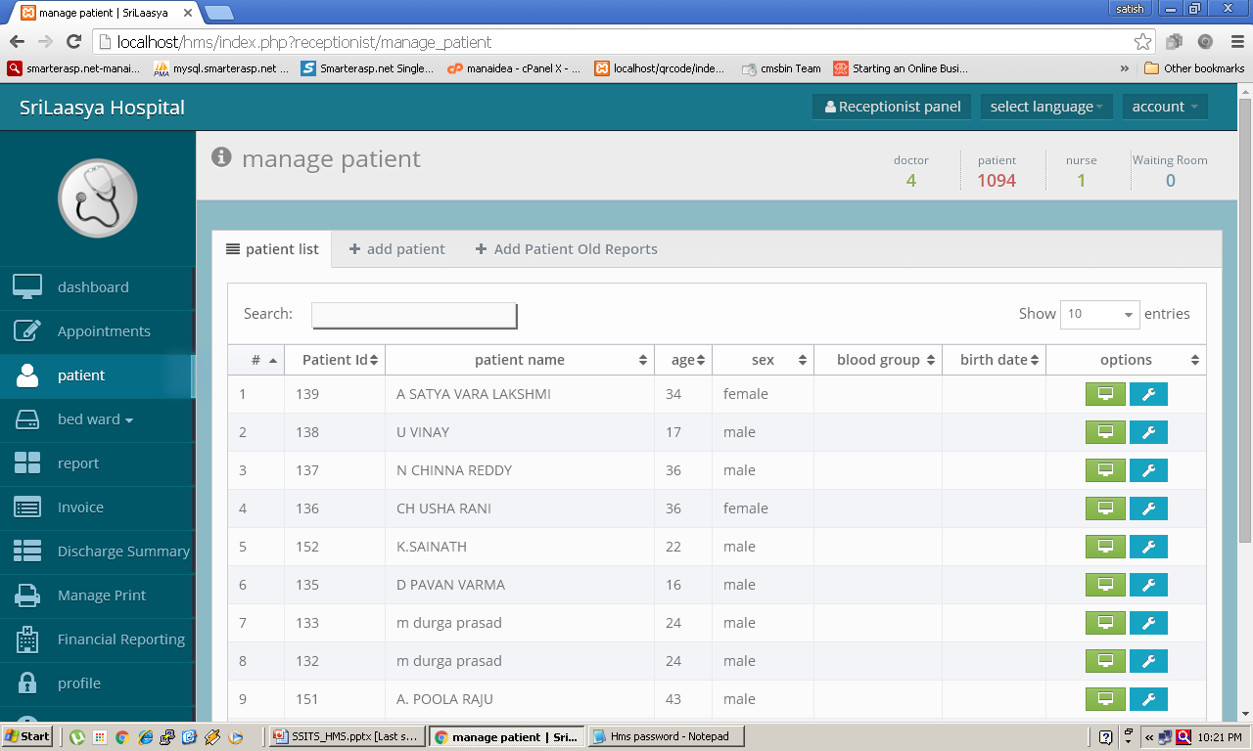
< Previous
Next >

Slide 33
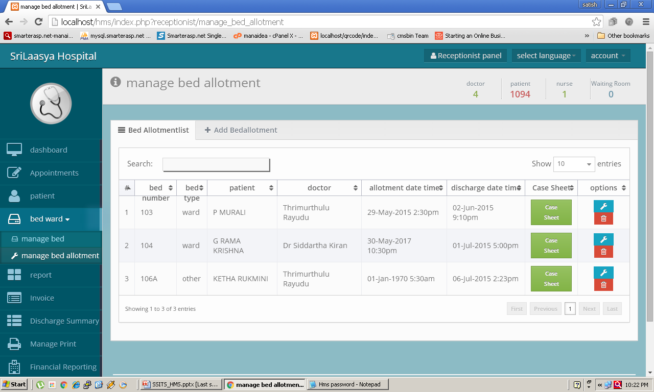
< Previous
Next >

Slide 34
< Previous
Next >

Slide 35
< Previous
Next >

Slide 36
< Previous
Next >

Slide 37
Next >

Slide 38
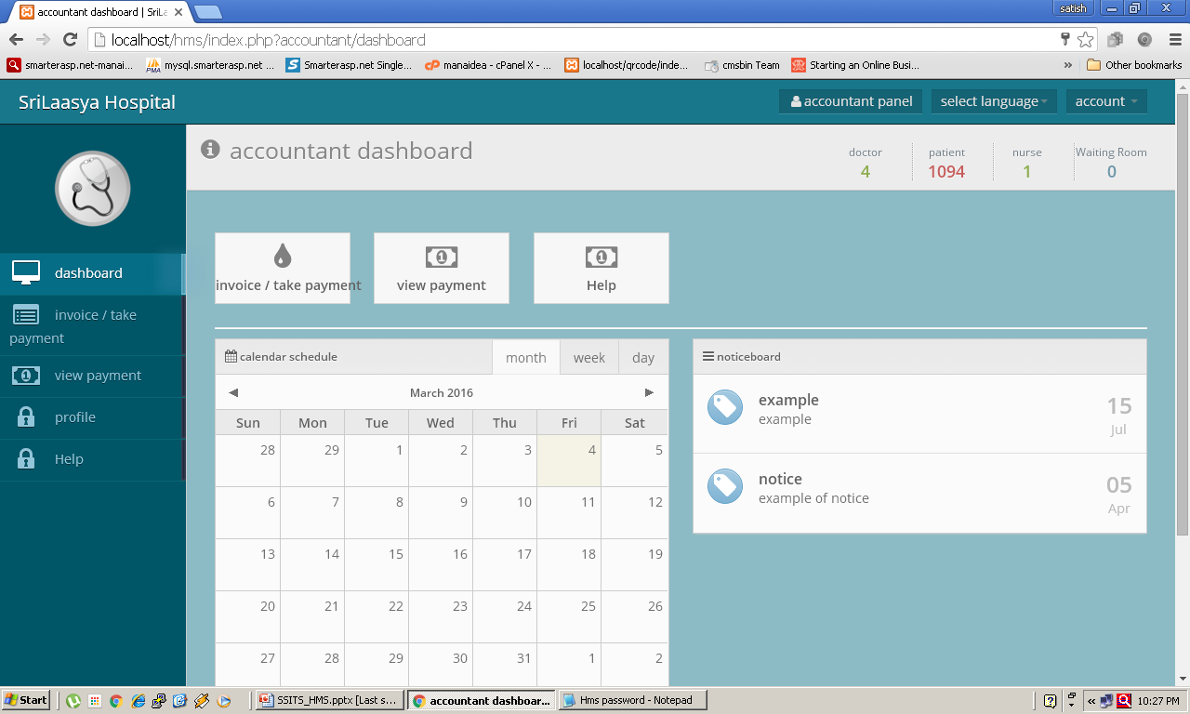
< Previous
Next >

Slide 39
< Previous
Next >

Slide 40
HMS-V1
HMS-V2
HMS-V3
Doctor Appointment
OP
Prescription Printing
OP Billing
Waiting hall Mgmnt
SMS / Email Alert
Lab Billing
Reports
Doctor Appointment
OP
Prescription Printing
OP Billing
Waiting hall Mgmnt
SMS / Email Alert
Lab Billing
HR & PayRoll
IP Billing
Pharmacy
Reports
Doctor Appointment
OP
Prescription Printing
OP Billing
Waiting hall Mgmnt
SMS / Email Alert
Lab Billing
HR & PayRoll
IP Billing
Pharmacy
OT Billing
Inventory
Birth Certificates
Reports

Slide 41
Contact Us
SSITS, HealthCare Soft Dev. Dept. Hyderabad
Email : sales@myhospitalcrm.com or sateeshh@gmail.com
Mobile : Satish – 8341016646 (WhatsApp) / 8341102235
Thank you
< Previous

